Slide 1
Chapter 5: Structural Modeling

Slide 2
Objectives
Understand the rules and style guidelines for creating CRC cards, class diagrams, and object diagrams.
Understand the processes used to create CRC cards, class diagrams, and object diagrams.
Be able to create CRC cards, class diagrams, and object diagrams.
Understand the relationship among structural models.
Understand the relationship between structural and functional models.
Notes:
What do Functional models represent?
What do Structural models represent?
Do the users & analysts receive any ancillary benefits from creating structural models?
What are system objects?
.

Slide 3
Structural Models
Drawn using an iterative process
First drawn in a conceptual, business-centric way
Then refined in a technology-centric way describing the actual databases and files
More and more detail is added in each iteration
Create a vocabulary for analysts & users
Allows effective communication between analysts & users
Notes:
Why are assumptions important to a structural model?

Slide 4

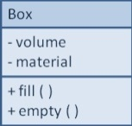
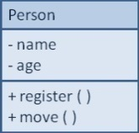
Structural Models
Main goal: to discover the key data contained in the problem domain and to build a structural model of the objects
Structural
Modeling
Solution Domain
Problem Domain
Notes:
Why is structural modeling important?

Slide 5
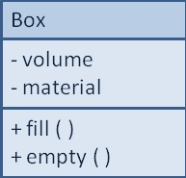
Classes, Attributes, & Operations
Classes
Templates for instances of people, places, or things
Attributes
Properties that describe the state of an instance of a class (an object)
Operations
Actions or functions that a class can perform
Notes:
What is a class?
What are some examples of classes?
What is an attribute?
What is a method or behavior?
What is a superclass?
What is a subclasses?

Slide 6
Relationships
Denotes associations between classes
Depicted with a line labeled with the name of the relationship
May be directional (depicted with a triangle; e.g., a patient schedules an appointment)
Classes may be related to themselves (e.g., employees and managers who may be members of the same class)
Multiplicity indicates how many of one class are related to another class
Notes:
What is a relationship?
How do you document & communicate relationships?

Slide 7
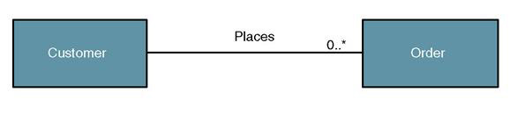
Class Diagram
Object/class relationship – a natural business association that exists between one or more objects and classes.
Notes:
Must there exist an instance of customer for each instance of order?
Must there exist an instance of order for each instance of customer?
How many instances of order can exist for each instance of customer?
How many instances of customer can exist for each instance of order?
Are all relationships / associations bi directional?
Describe to a Business Person the multiplicity of a relationship between two classes.

Slide 8
Generalization & Aggregation Associations
Generalization denotes inheritance
Properties and operations of the superclass are valid for the sub-class
Depicted as a solid line with a hollow arrow pointing at the superclass
Aggregation denotes a logical “a-part-of” relationship
Composition denotes a physical “a-part-of” relationship
Notes:
What is Generalization?

Slide 9
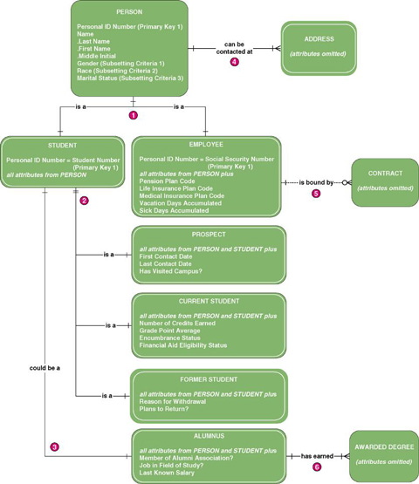
Notes:
Why doesn’t student or employee have name as attribute?
For every instance of student is there an instance of Person?
For every instance of Person is there an instance of Student?

Slide 10
Notes:
Is student a subclass or superclass?
Does this model include any Abstract objects?
Does this model include any Concrete objects?

Slide 11
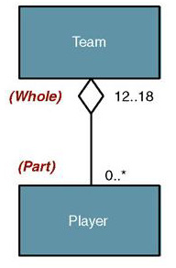
Aggregation
Aggregation – a relationship in which one larger “whole” class contains one or more smaller “parts” classes. Conversely, a smaller “part” class is part of a “whole” larger class
In UML 2.0 the notation for aggregation has been
dropped
Notes:
Aggregation is analogous to the “whole” is the sum of the parts. Do aggregation relationships support inheritance?
Who can give me an example of an aggregation relationship?
How many players are on the team in this slide?

Slide 12
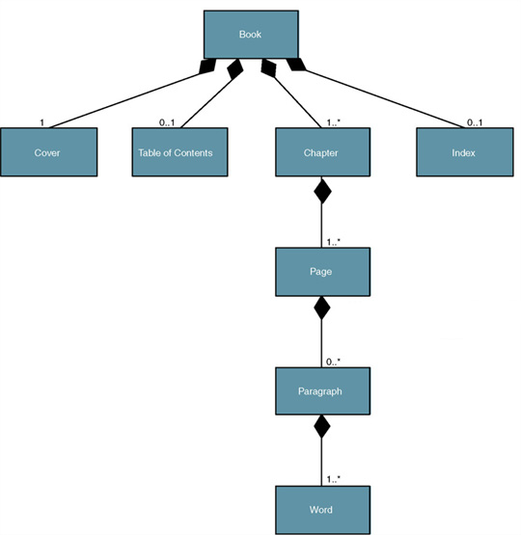
Composition
Composition – an aggregation relationship in which the “whole” is responsible for the creation and destruction of its “parts.” If the “whole” were to die, the “part” would die with it
Notes:
Are all composition relationships aggregation relationships?
Are all aggregation relationships composition relationships?
Was this the same diamond we used on the prior slide?
Why is the book class composition & the team class on the prior slide aggregation?

Slide 13
Relationships
Describe how classes relate to one another
Three basic types in UML
Generalization
Enables inheritance of attributes and operations
Represents relationships that are “a-kind-of”
Aggregation
Relates parts to wholes or assemblies
Represents relationships that are “a-part-of” or “has-parts”
Association
Miscellaneous relationships between classes
Usually a weaker form of aggregation
Notes:
What is an association relationship?

Slide 14
Multiplicities
Exactly one:
A department has one and only one boss
Department
Boss
1
1
Zero or more:
An employee has zero to many children
Employee
Child
1
0..*
One or more:
A boss is responsible for one or more employees
Boss
Employee
1
1..*
Notes:
Another name for Multiplicities is Cardinality. What is Multiplicity or Cardinality?
Are these relationships are bidirectional?
Does that fact that all relationships are bidirectional impact Multiplicities is Cardinality?

Slide 15
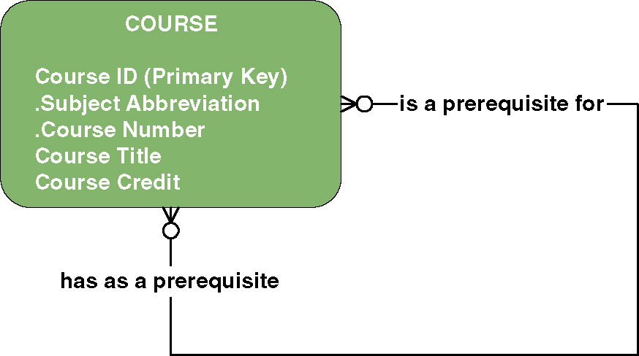
Recursive relationship - a relationship that exists between instances of the same entity
Notes:
What is a recursive relationship?
Who can describe this diagram?
What are some other examples of recursive relationships?

Slide 16
What is a class?

Slide 17
Describe to a Business Person the multiplicity of a relationship between two classes.

Slide 18
What is the purpose is the association class?

Slide 19
How are structural models depicted & communicated?

Slide 20
Abstract classes are used to create objects.
T / F?

Slide 21
Is there any benefit to develop a Structural Model of the current system?

Slide 22
Why do we perform Structural Modeling?

Slide 23
One of rules for verifying the structural model is to check that the object type of the attributes listed on the back of the CRC card and with the attributes in the attribute list of the class on a class diagram implies _______________from the class to the class of the object type.
a. an inheritance
b. an aggregation
c. a dependence
d. an association
e. a communication

Slide 24
What is a structural model?

Slide 25
Why should a systems analyst create a structural model?

Slide 26
Why is the creation of a structural model iterative?

Slide 27
What is a relationship?

Slide 28
Describe the types of relationships that you may have on a class diagram.

Slide 29
Object Identification
Textual analysis of use-case information
Nouns suggest classes
Verbs suggest operations
Creates a rough first cut to provide an object list
Brainstorming—people offering ideas
Initial list of classes (objects) is developed
Attributes, operations and relationships to other classes can be assigned in a second round
Notes:
What is Brainstorming? Brainstorming
What is textual analysis?

Slide 30
Partial Use-Case Narrative with Nouns Highlighted
Notes:
No additional notes.

Slide 31
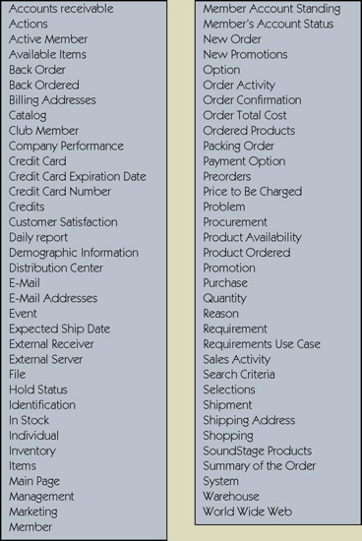
Potential Object List
Notes:
No additional notes.

Slide 32
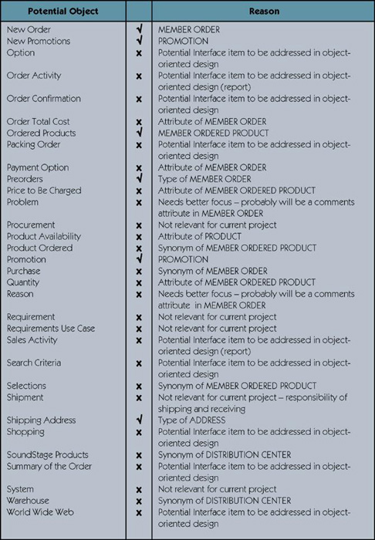
Cleaning Up List of Candidate Objects

Slide 33
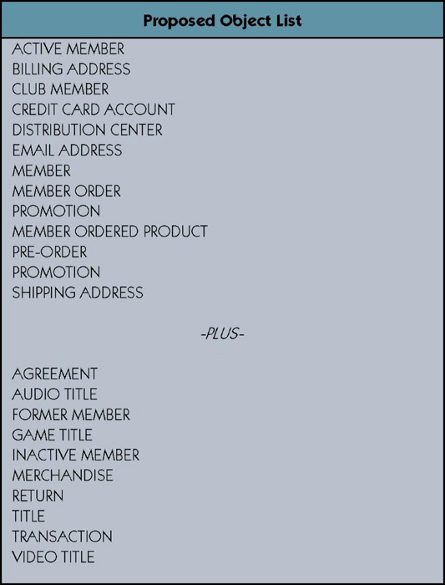
Proposed Object List
Notes:
No additional notes.

Slide 34
Object Identification (cont.)
Common Object Lists
Physical things
Incidents
Roles
Interactions
Patterns
Useful groupings of collaborating classes that provide solutions to common problems (are reusable)
Developed patterns provide a starting point for work in similar domains
Notes:
What are some examples of Physical Things?
What are some examples of Events?
What are some examples of Roles?
What are some examples of Interactions?
What are some examples of Patterns?

Slide 35
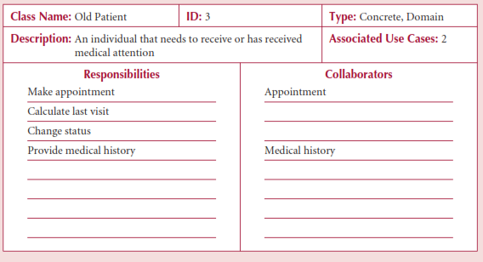
Front-Side of a CRC Card
Notes:
What are CRC (Class Responsibility Collaboration) cards?
What are Class Responsibilities?

Slide 36
Front-Side of a CRC Card
Notes:
What are structural models?
What is Collaboration?

Slide 37
CRC Cards & Role-Playing
An exercise to help discover additional objects, attributes, relationships & operations
Team members perform roles associated with the actors and objects previously identified
Utilize activity diagrams
Notes:
What role do activity diagrams paly?
How do CRC cards relate to structural models?
What is on the front of the CRC card?
What is on the back of the CRC card?
What role do team members play during a role playing exercise?
What is the goal of role playing?

Slide 38
Attributes
Properties of a class
Person: last name, first name, address, etc.
Attributes can be derived
Preceded with a slash (/)
e.g., age is derived from date of birth
Visibility of an attribute:
Restricts access to attributes to ensure consistency
Public attributes (+): visible to all classes
Private attributes (-): visible only to an instance of the class in which they are defined
Protected attributes (#): visible only to an instance of the class in which they are defined and its descendants
Notes:
What are derived attributes?
What are some examples of derived attributes that may exist on a class diagram.
How would they be denoted on the class diagram?
What is visibility?
What are the different types of visibility?
How would they be denoted on a class diagram?
.

Slide 39
Operations
Common operations are not shown
Create or delete an instance
Return or set a value
Types of operations:
Constructor—creates an object
Query—makes information about the state of an object available
Update—changes values of some or all of an object’s attributes
Destructor—deletes or removes an object
Notes:
What are some examples of Update Operations?
What are some examples of Query Operations?
What are some examples of Constructor Operations?
Which operations would not need to be shown in the class rectangle?

Slide 40
What is a method or behavior?

Slide 41
Which of the following would most likely not be an example of an attribute?
a. employee name
b. customer address
c. stock number
d. ISBN number
e. cancel appointment

Slide 42
Which of the following will be converted to methods in later phases of the SDLC?
a. attributes
b. operations
c. classes
d. objects
e. abstract classes

Slide 43
What is Brainstorming?

Slide 44
What is an attribute?

Slide 45
Association Classes
Common in many-to-many relationships
Used when attributes about the relationship between two classes needs to be recorded
Students are related to courses; a Grade class provides an attribute to describe this relationship
Illnesses are related to symptoms; a Treatment class provides an attribute to describe this relationship
Notes:
What is the purpose is the association class?

Slide 46
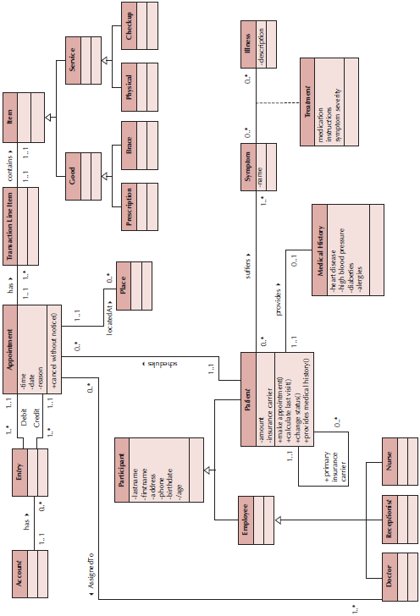
Sample Class Diagram
Notes:
Are fully populated class diagrams of real-world systems easy to understand?
What are some ways of simplifying class diagrams?

Slide 47
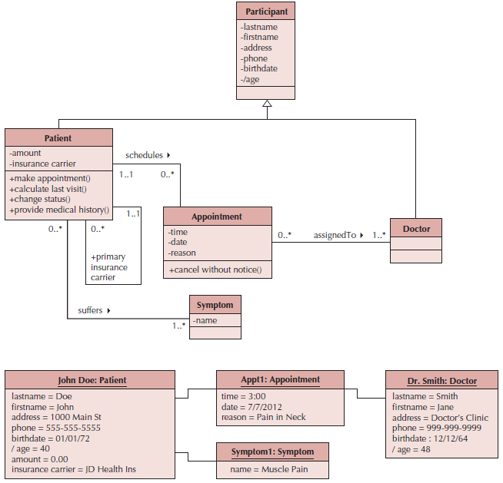
Example Object Diagram
Notes:
What are Object Diagrams?
What is the purpose of an Object Diagram?

Slide 48
7 Steps to Structural Models
Create CRC Cards
Review CRC Cards & identify missing objects, attributes, operations and/or relationships
Role-play the CRC cards—look for breakdowns & correct; create new cards as necessary
Create the class diagram
Review the class diagram—remove unnecessary classes, attributes, operations and/or relationships
Incorporate patterns
Review and validate the model
Notes:
How are structural models depicted & communicated?
How do we make sure all three are in sync or properly verified and validated?

Slide 49
Verifying & Validating the Model
Analyst presents to developers & users
Walks through the model
Provides explanations & reasoning behind each class
Rules
Each CRC card is associated with a class
Responsibilities on the front of the card are included as operations on the class diagram
Collaborators on the front of the card imply a relationship on the back of the card
Attributes on the back of the card are listed as attributes on the class diagram
Notes:
In addition to the rules on this slide what else should we worry about?

Slide 50
Read Mini case #1 on Pages #200 & #201

Slide 51
What is your response to the director of operations?

Slide 52
Coastline Systems Consulting
Read
Coastline Systems
(Class Hand Out)

Slide 53
Coastline Systems Consulting
List 4 outstanding problems or opportunities and their associated causes & effects
Identify and classify the requirements of the proposed system

Slide 54
Coastline Systems Consulting
List 4 outstanding problems or opportunities and their associated causes & effects

Slide 55
Coastline Systems Consulting
Identify and classify the requirements of the proposed system

Slide 56
Read Mini case #2 on Pages #201

Slide 57
Identify the six classes described in mini case #2

Slide 58
A(n) _____ formalizes the interactions between a client and server object.
a. relationship
b. contract
c. abstract object
d. concrete object
e. abstraction

Slide 59
A collaboration consists of _____.
a. two instances of a class talking with each other
b. two instances of a class knowing the value of each others attributes
c. a set of classes that share common operations
d. a set of classes that are all related to one another
e. a set of classes involved in a use case

Slide 60
The responsibilities of a class can be divided into knowing and doing types.
T / F?

Slide 61
Object diagram is just another name for class diagram; they both show the same information.
T / F?

Slide 62
A view is used to simplify a class diagram by subsetting the information available on the diagram for viewing.
T / F?

Slide 63
The four most common approaches have been suggested to aid the analyst in identifying a set of candidate objects for the structural model are textual analysis, brainstorming, common object lists, and design patterns.
T / F?

Slide 64
What is a CRC card?

Slide 65
Why should an analyst create a CRC card?

Slide 66
What are the essential elements of a CRC card?

Slide 67
Describe how views help simplify class diagrams.

Slide 68
Describe how packages help simplify class diagrams.

Slide 69
Describe the patterns method for identifying candidate objects for a structural model.

Slide 70
Train the Trainer, Inc.
Read Train the Trainer
(Class Handout)

Slide 71
Train the Trainer, Inc.
What are some examples of Zero or Many?
What are some examples of Zero to One?
What are some examples of One and only One?
What are some examples of One or Many?

Slide 72
Train the Trainer, Inc.
What are some examples of Zero or Many?

Slide 73
Train the Trainer, Inc.
What are some examples of Zero to One?

Slide 74
Train the Trainer, Inc.
What are some examples of One and only One?

Slide 75
Train the Trainer, Inc.
What are some examples of One or Many?

Slide 76
Do the users & analysts receive any ancillary benefits from creating structural models?

Slide 77
What is a subclass?

Slide 78
What are some examples of classes?

Slide 79
What is textual analysis?

Slide 80
What are structural models?

Slide 81
How do CRC cards relate to structural models?

Slide 82
What is on the front of the CRC card?

Slide 83
What is on the back of the CRC card?

Slide 84
What role do team members play during a role playing exercise?

Slide 86
What are some examples of classes? There are domain classes, user-interface classes, document classes & various types of multimedia classes.

